Slide 1

Convolutional Neural Networks
Why convolutions?
deeplearning.ai

Slide 2
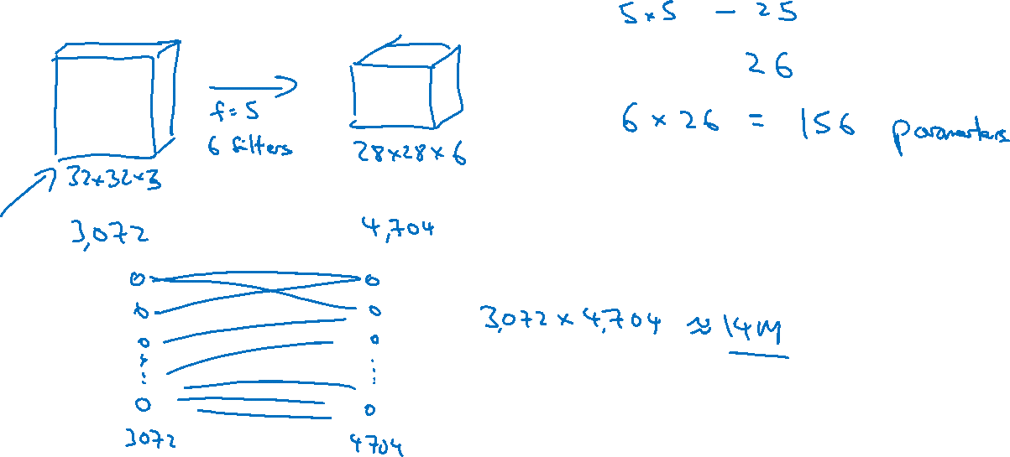
Why convolutions
Notes:
So, each filter has 25 parameters,
plus a bias parameter miss of 26 parameters per a filter,
and you have six filters, so,
the total number of parameters is that,
which is equal to 156 parameters.

Slide 3

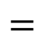
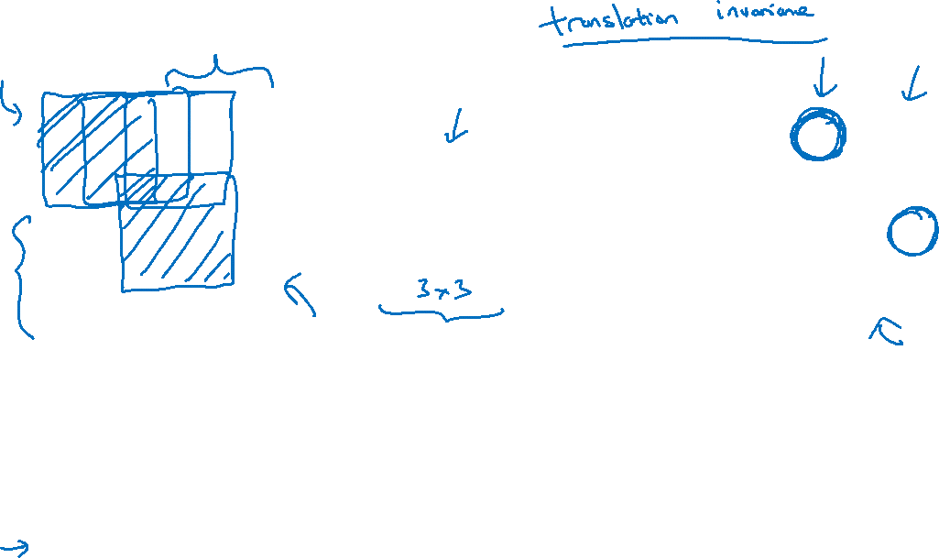
Why convolutions
10 | 10 | 10 | 0 | 0 | 0
10 | 10 | 10 | 0 | 0 | 0
10 | 10 | 10 | 0 | 0 | 0
10 | 10 | 10 | 0 | 0 | 0
10 | 10 | 10 | 0 | 0 | 0
10 | 10 | 10 | 0 | 0 | 0
0 | 30 | 30 | 0
0 | 30 | 30 | 0
0 | 30 | 30 | 0
0 | 30 | 30 | 0
1 | 0 | -1
1 | 0 | -1
1 | 0 | -1
$$∗$$
$$=$$
Parameter sharing: A feature detector (such as a vertical edge detector) that’s useful in one part of the image is probably useful in another part of the image.
Sparsity of connections: In each layer, each output value depends only on a small number of inputs.
Notes:
small parameters is really two reasons.
One is parameter sharing.
And parameter sharing is motivated by the observation
that feature detector such as vertical edge detector,
that's useful in one part of the image is probably useful in another part of the image.
参数：大家都能用，所以参数数目不必太多
sparsity of connections：
as if only those nine input features are connected to this output,
and the other pixels just don't affect this output at all.
计算左上角绿色的0的，是来自左上角的九个pixel，其他pixels影响不了它
Translation invariance
一直猫，它全部部分向右移动几个pixel，还是一只猫

Slide 4


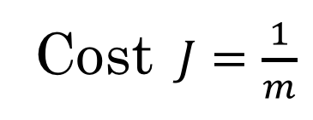

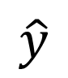
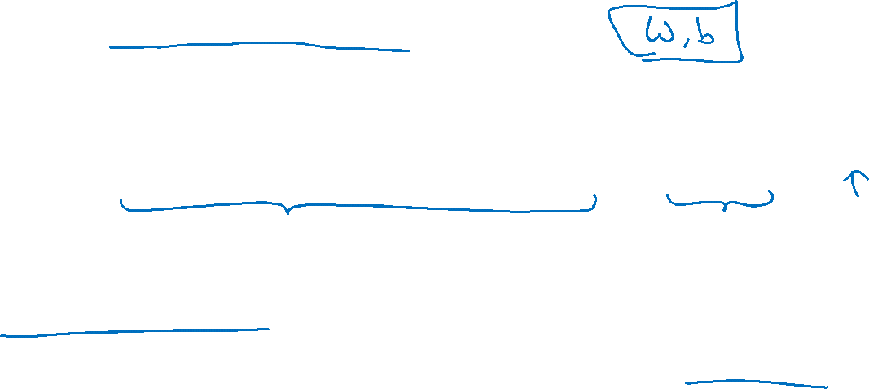
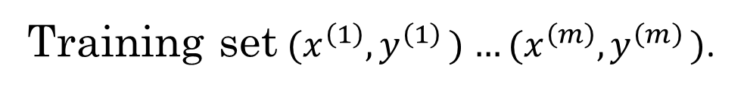
Putting it together
Training set$(x^{\left(1\right)}{,y}^{\left(1\right)})$ $…(x^{\left(m\right)}{,y}^{\left(m\right)})$.
$$\hat{y}$$
Cost $J=\frac{1}{m}$
$$\sum_{i=1}^{m}{ }$$
$$ℒ({\hat{y}}^{\left(i\right)},y^{\left(i\right)})$$
Use gradient descent to optimize parameters to reduce $J$

